Slide 1
Foresight – Global Change Analytics: Communicating complex science through interactive dashboards
Zarrar Khan, Taryn Waite,
Hassan Niazi, Mengqi Zhao, Chris Vernon

Slide 2
Introduction

Slide 3
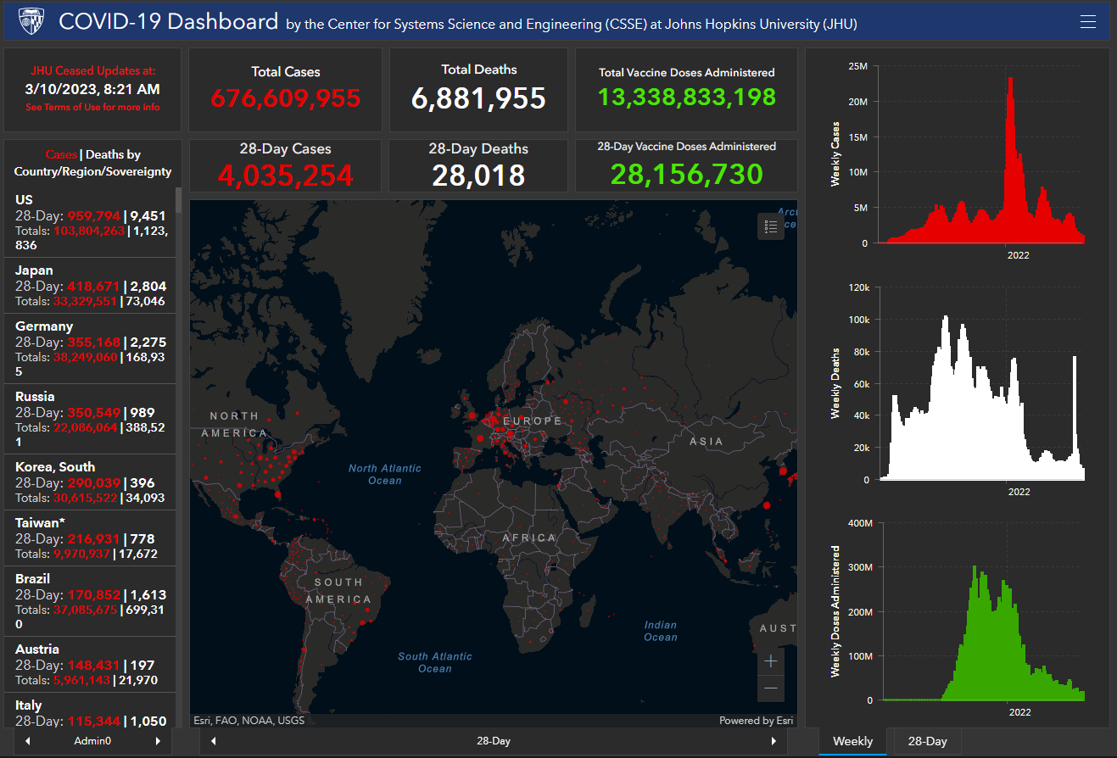
Introduction - Dashboarding
What is a dashboard?
Live visual interface that displays key data and metrics
Linked to a database
Provides a snapshot of important information in real-time or near-real-time
Enables quick identification of areas of concern and trends
Helps inform decision-making and drive action.
https://coronavirus.jhu.edu/map.html

Slide 4

Introduction – Slido Survey
Join at
www.Slido.com
#4138202

Slide 5


If you weren't a human what would you like to be?
ⓘ Start presenting to display the poll results on this slide.

Slide 6
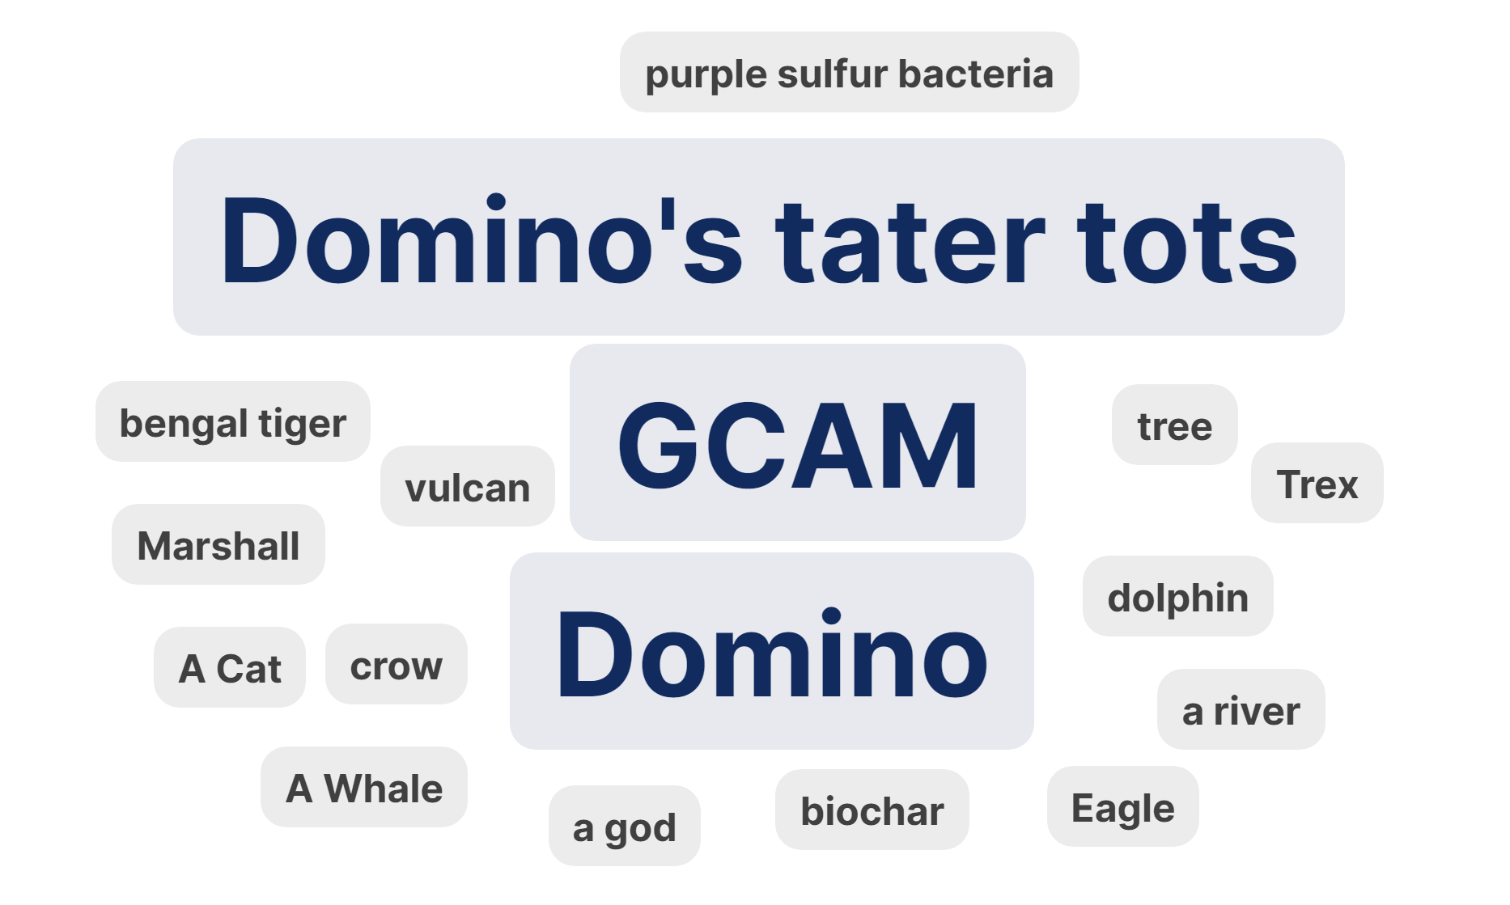
If you weren’t a human what would you like o be?
Join at www.slido.com 4138202
JGCRI 13 Apr 2023

Slide 7
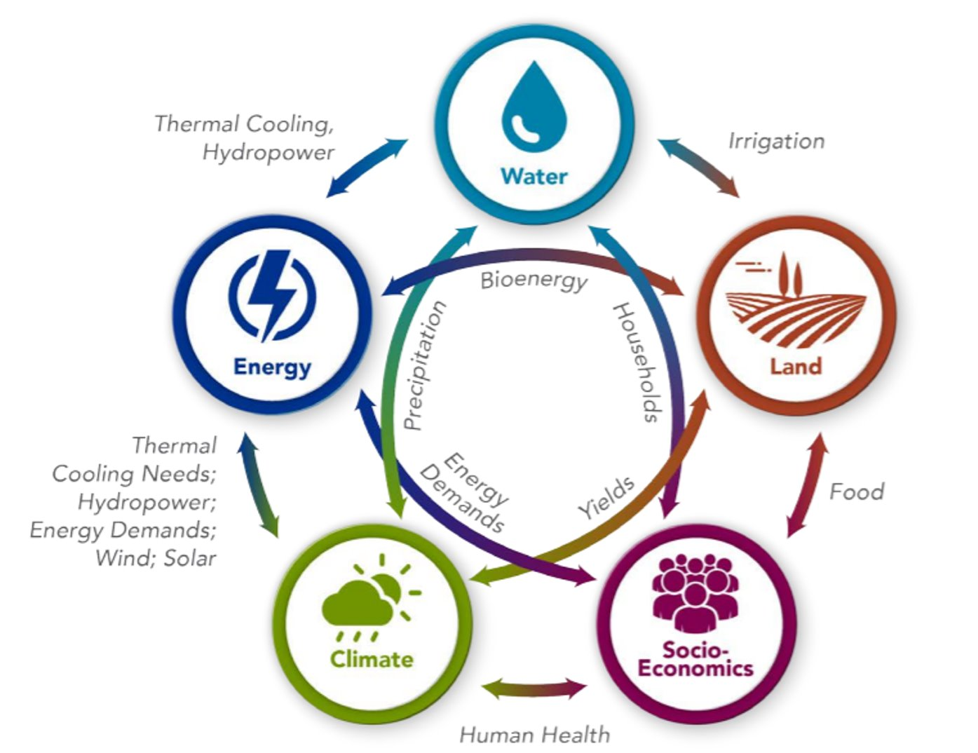
Integrated Assessment Modeling (IAM)
Join at www.slido.com 4138202
Global Change Analysis Model (GCAM)
Represents socio-economics, energy, water, agriculture, land-use, and climate systems.
GCAM used to capture long term (2100) multi-sector global dynamics​
Solved using a market-equilibrium approach to balance demands and supplies in regional markets for different commodities.​
One of the selected models used by the IPCC in all its reports

Slide 8
Motivation

Slide 9
What do you think are some benefits of a dashboard?
ⓘ Start presenting to display the poll results on this slide.

Slide 10
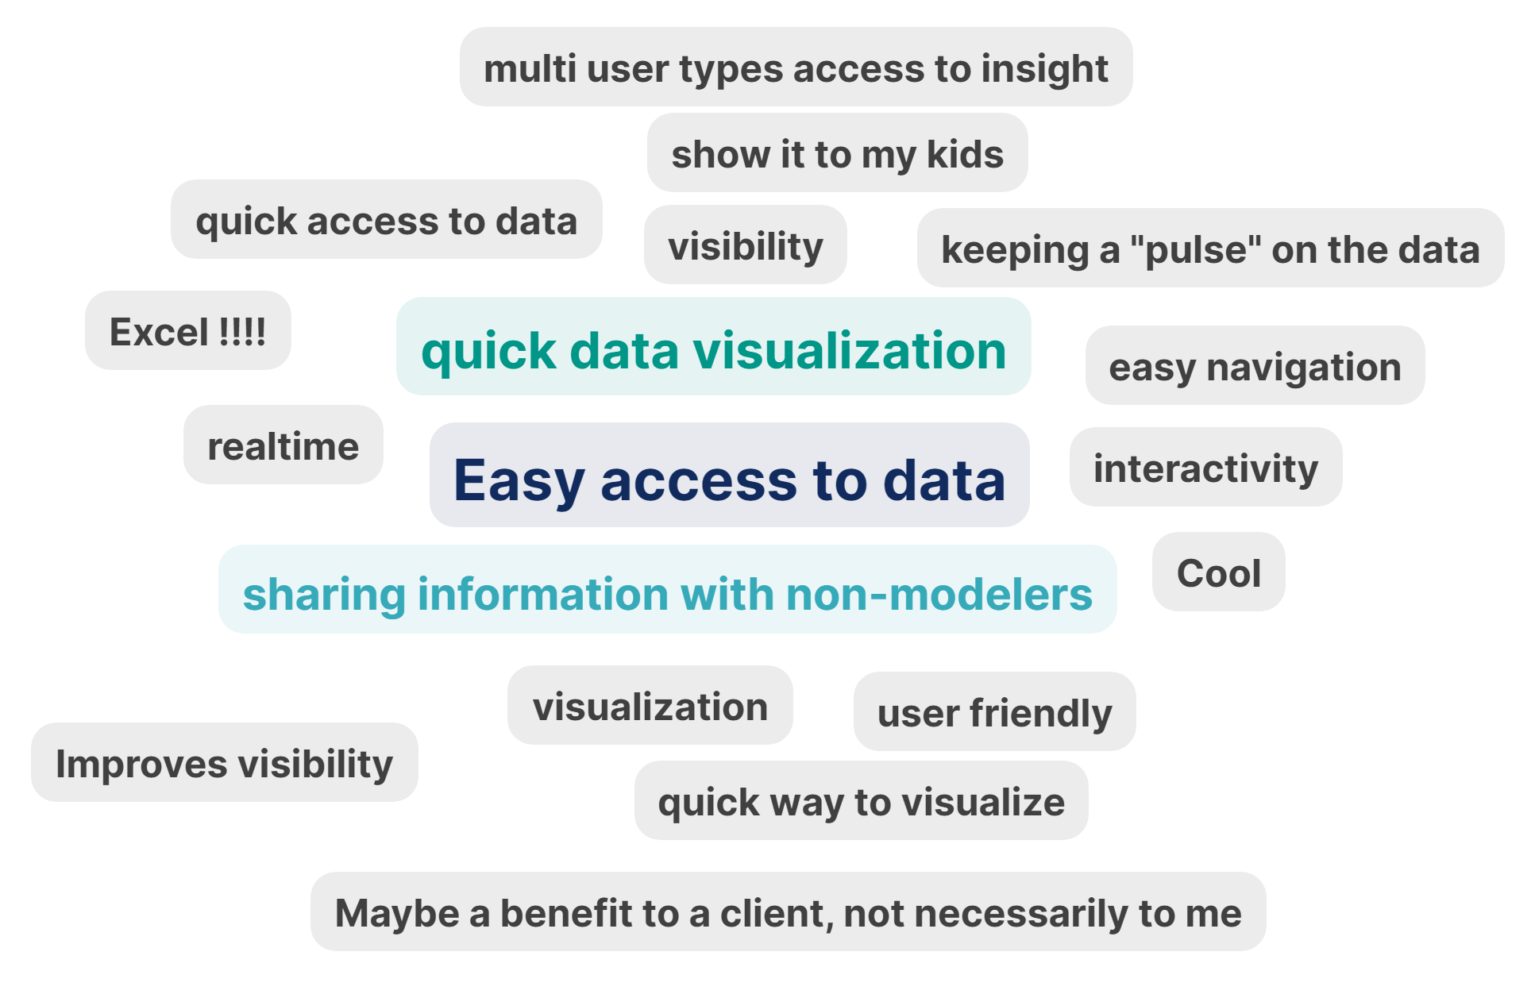
What do you think are some benefits of having a dashboard?
Join at www.slido.com 4138202
JGCRI 13 Apr 2023

Slide 11
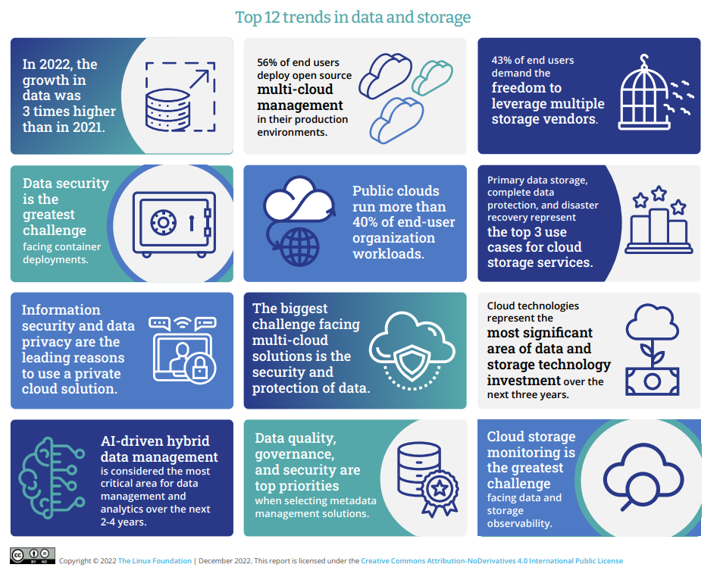










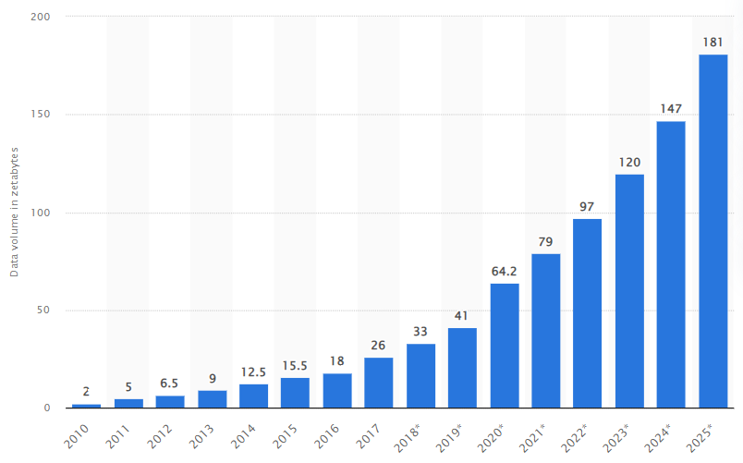











Motivation – Need
Join at www.slido.com 4138202
Tracking Indicators & Trends
Storytelling
Complex Data
Growth of Data & Complexity
Accessible Insights
Institutional Hive-Mind
Avoid SINGLE-USE research
Visibility
Notes:
Dashboards are useful tools for visualizing data and information in a concise and meaningful way. They are used to present a quick and easy-to-understand overview of key metrics and indicators, which allows users to make informed decisions based on the data.
Data – growing projects, runs, products, data. In https://www.statista.com/statistics/871513/worldwide-data-created/. According to IBM in 2013, 90% of the data was produced in last two years. Over next two years till 2025 we would double our data production (181) compared to today (97). Indicators – with this huge influx of big data keeping track of key indicators and trends becomes difficult. Model changes, new studies come in, Story – without all this story telling becomes difficult.
First three things I have talked about speaks to the importance of going from data to information to story. We all do that in our daily tasks, products, and papers.
But I want you to take a pause and think of one product that we as an institution use to present that information to the world. Papers don’t count. And Zarrar’s metarepos don’t count.
Accessible -
Big data facts: How much data in Zettabytes do we produce? What is the rate of change of data production since 2020?
PNNL's data and dashboard efforts: What is the storage capacity of PNNL's deception cluster? MSD-live. Climate dashboard
What is difference in the size of a db from gcamv5 run vs gcamv6 run?

Slide 12
Scope

Slide 13
Who do you think is your potential audience?
ⓘ Start presenting to display the poll results on this slide.

Slide 14
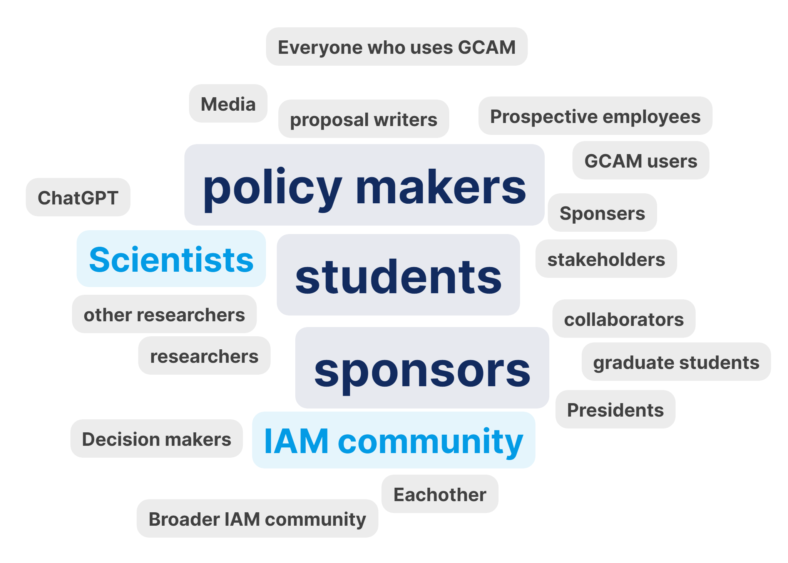
Who do you think is your potential audience?
Join at www.slido.com 4138202
JGCRI 13 Apr 2023

Slide 15
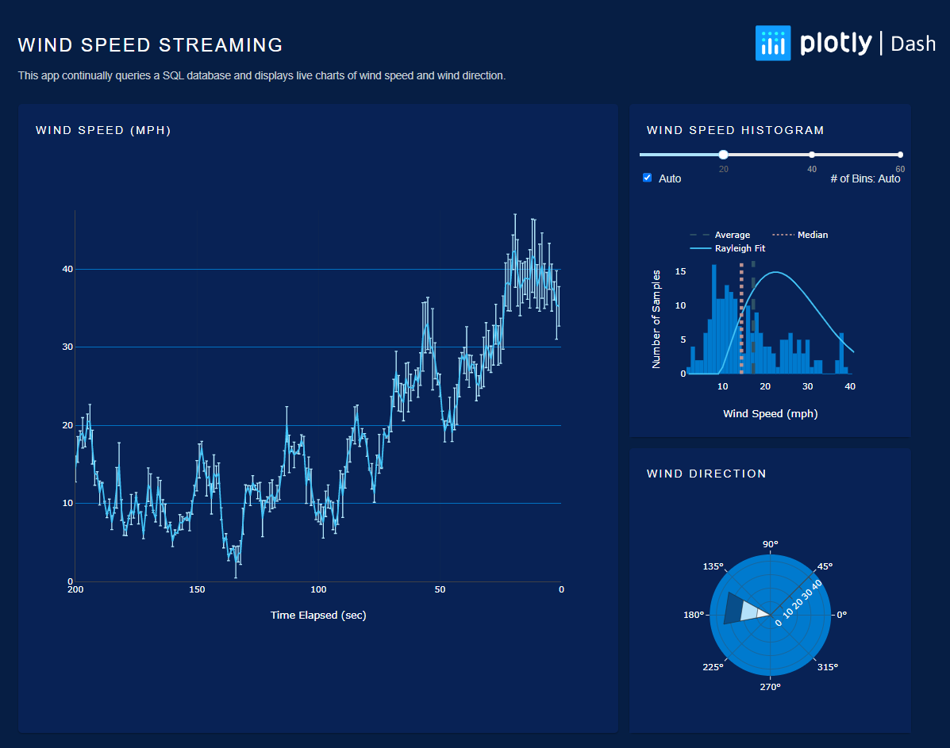
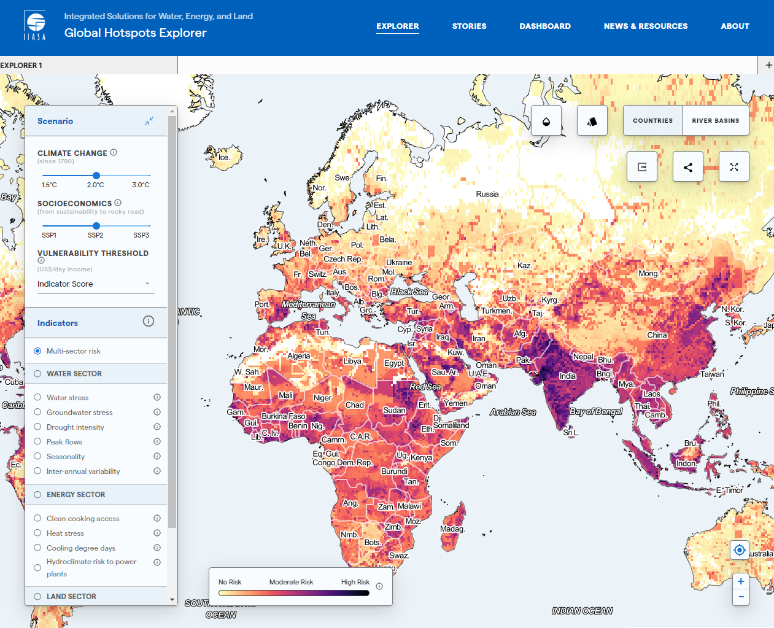
Scope: Audience
Join at www.slido.com 4138202
What information we show and How we show it will depend on the audience
https://dash.gallery/dash-wind-streaming/
IIASA Hotspot Explorer

Slide 16
Design

Slide 17
Design: Dashboard Elements
Join at www.slido.com 4138202
Content
Relevant
Digestible
Layout
Grouped data
White Space
Color
Sparingly
Deliberately
Flat UI
Accessibility
Fonts
Consistent
Max 3 sizes
Visualizations
Chart choices
Placement
Cross-filtering
Responsiveness
Multiple OS
Multiple devices
Screen sizes
Data
Availability
Transparency
https://www2.insightsoftware.com/dashboard-design-guide/dashboard-design-fundamentals/

Slide 18
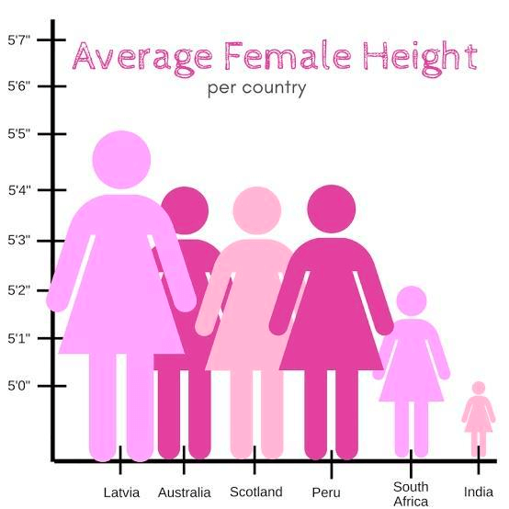
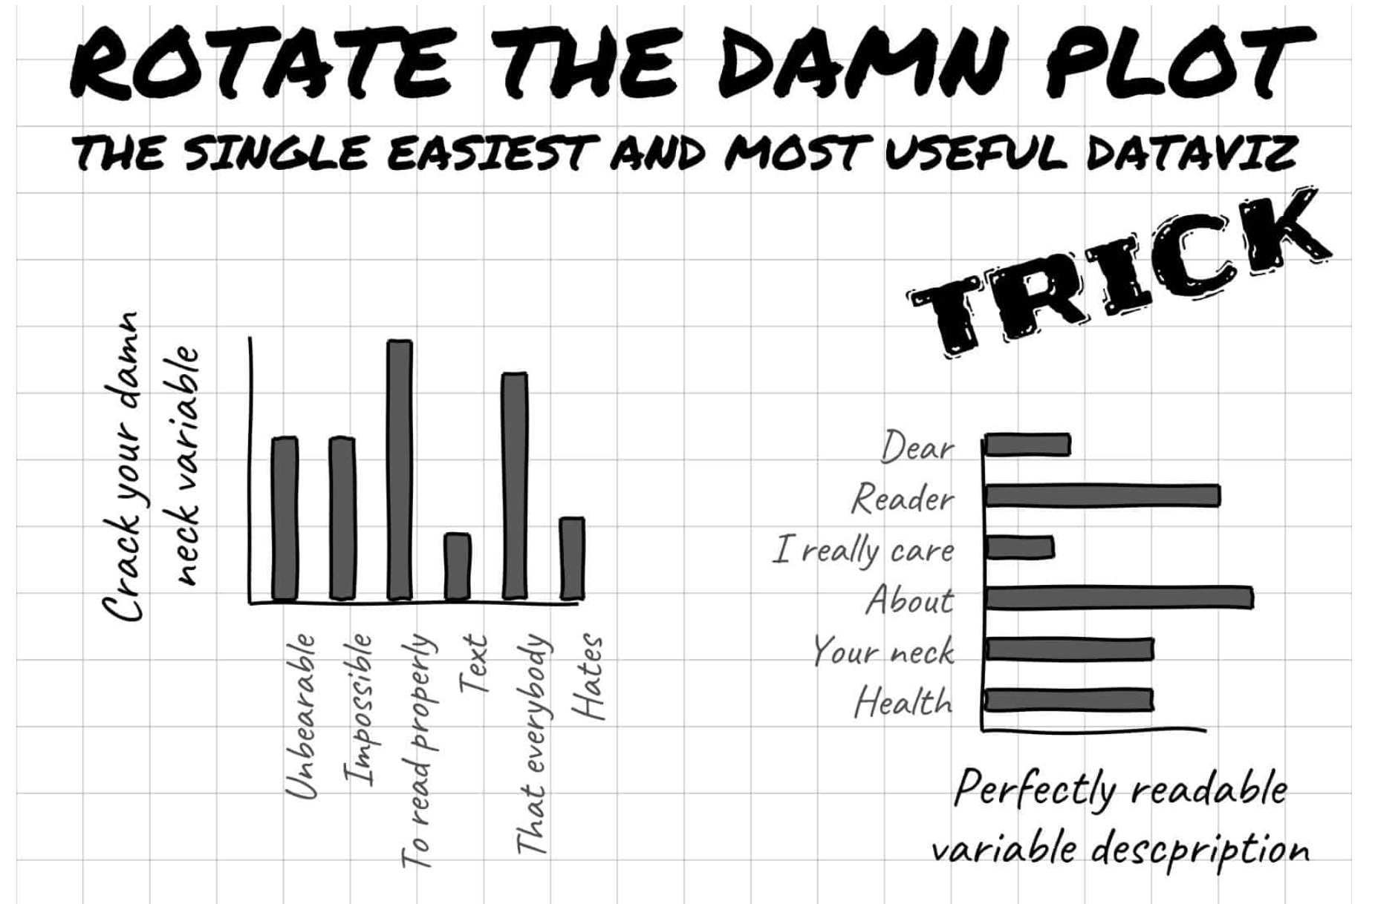
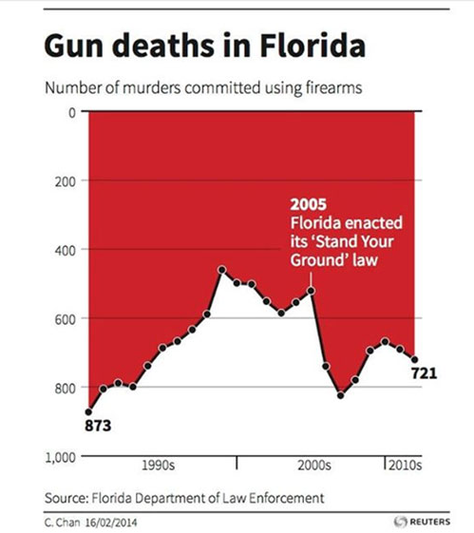
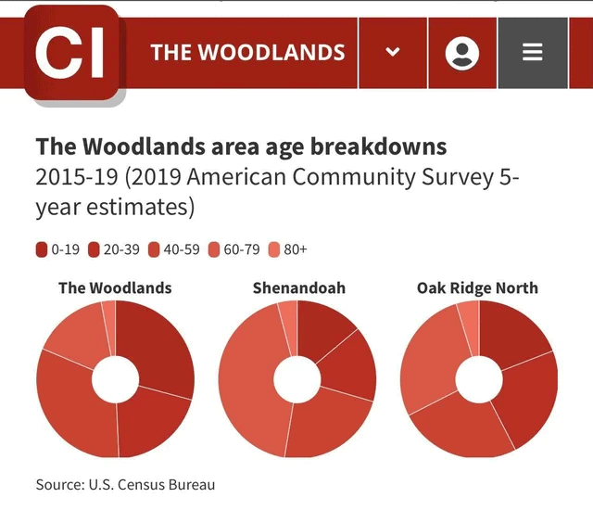
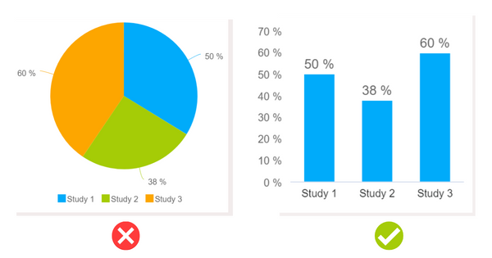
Design:Visualization mistakes to avoid
Join at www.slido.com 4138202
Cropped Y Axis
Readability
Misrepresenting Data
Color Scale Choices
Using inappropriate charts
Notes:
VIsualization examples: https://www.oldstreetsolutions.com/good-and-bad-data-visualization
- Viz examples: https://www.datapine.com/blog/misleading-data-visualization-examples/
- Viz Examples: https://ninjatables.com/bad-data-visualization-examples/
- Viz Examples: https://wpdatatables.com/misleading-data-visualization-examples/

Slide 19
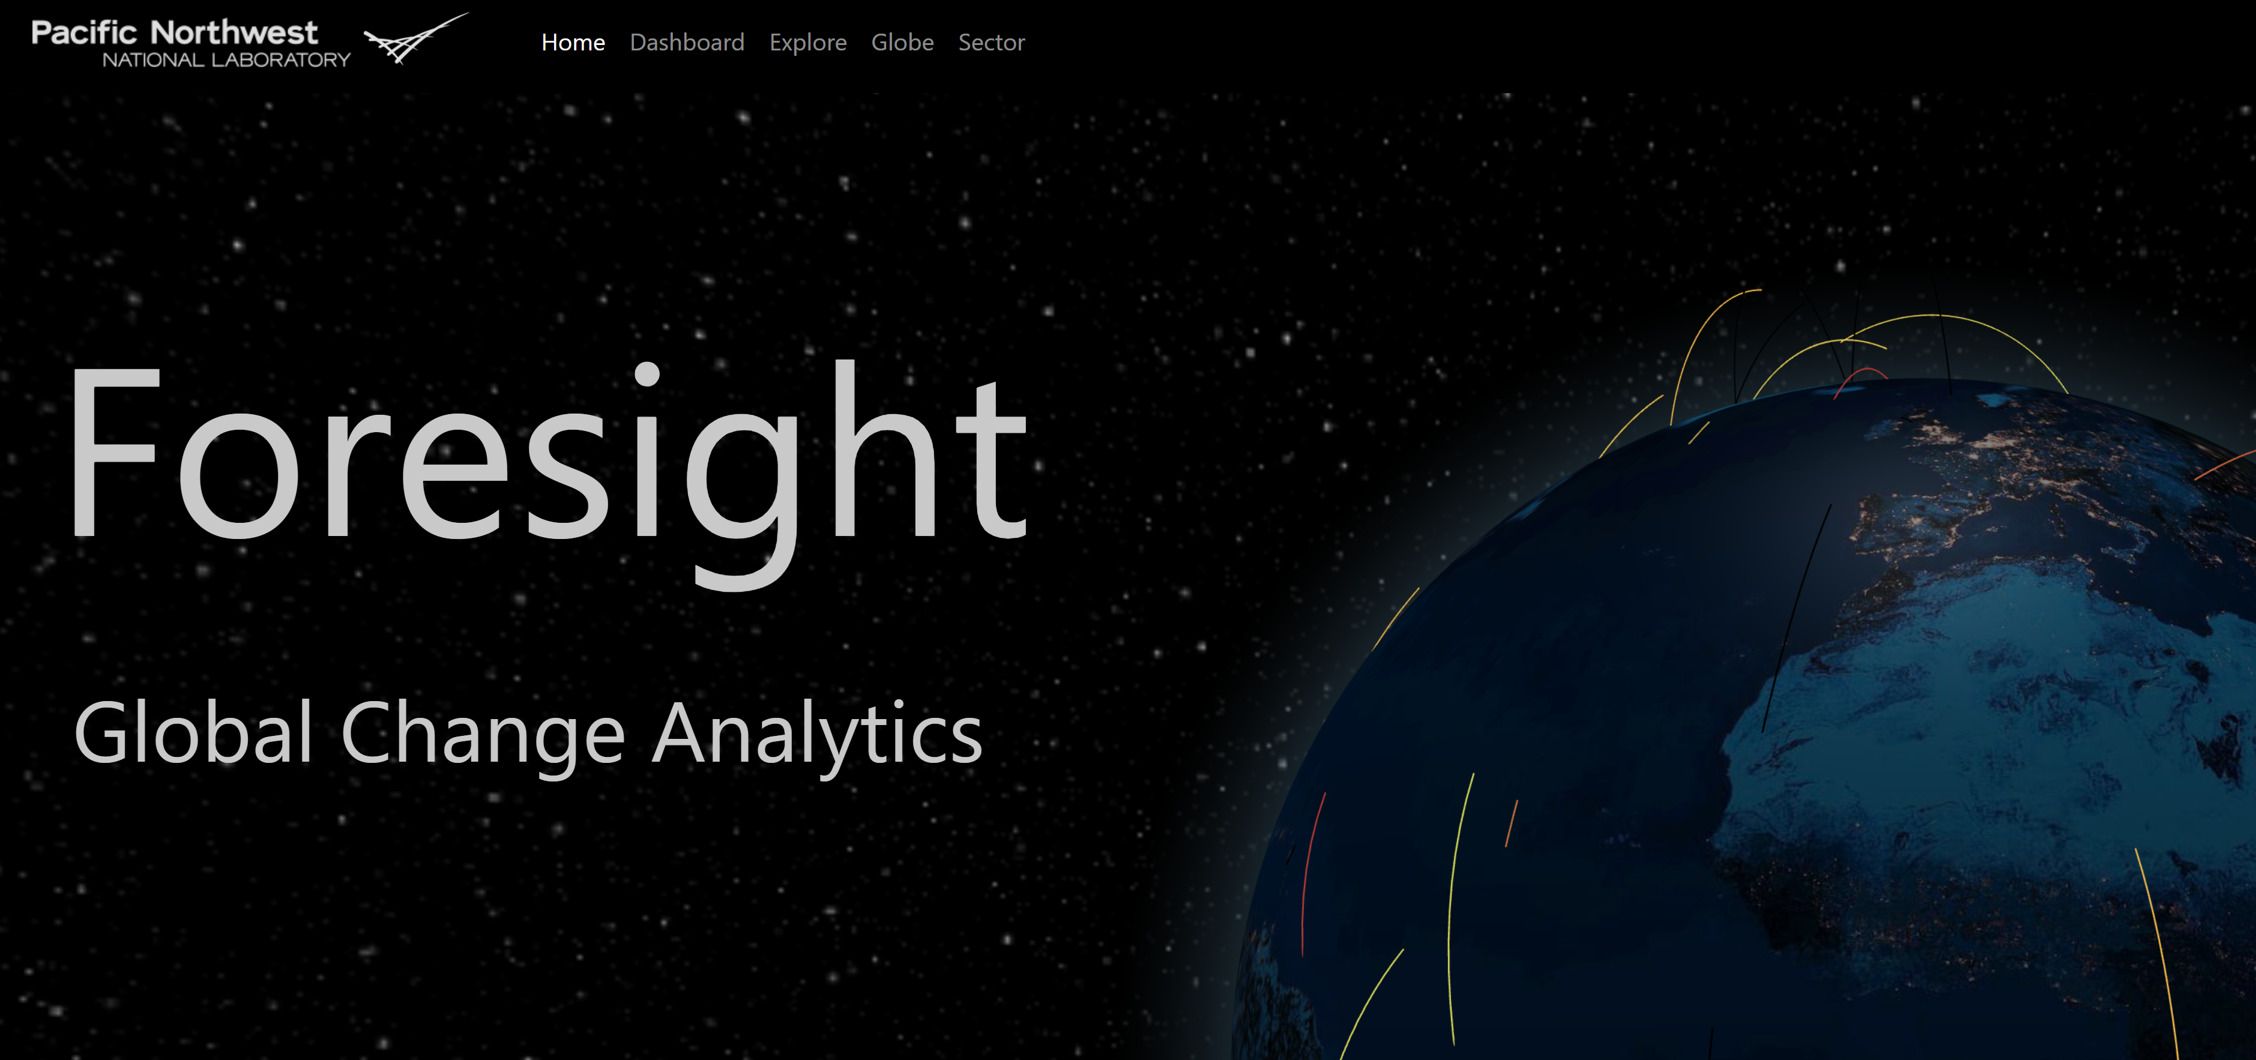
Preview Foresight
Join at www.slido.com 4138202

Slide 20


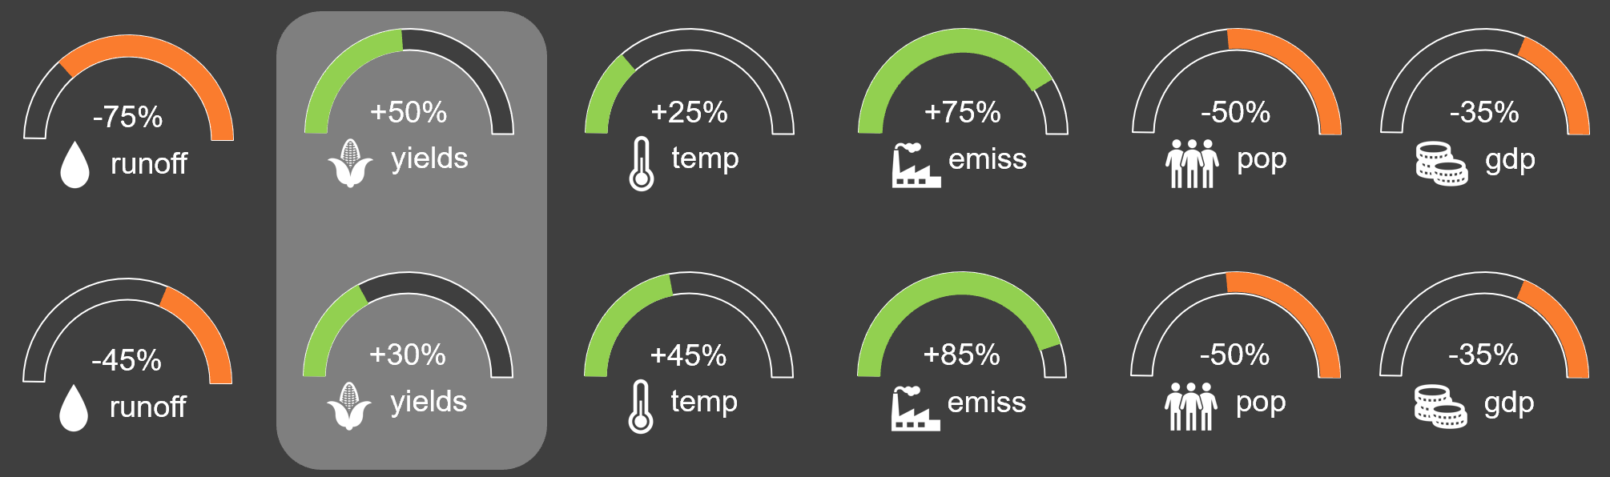





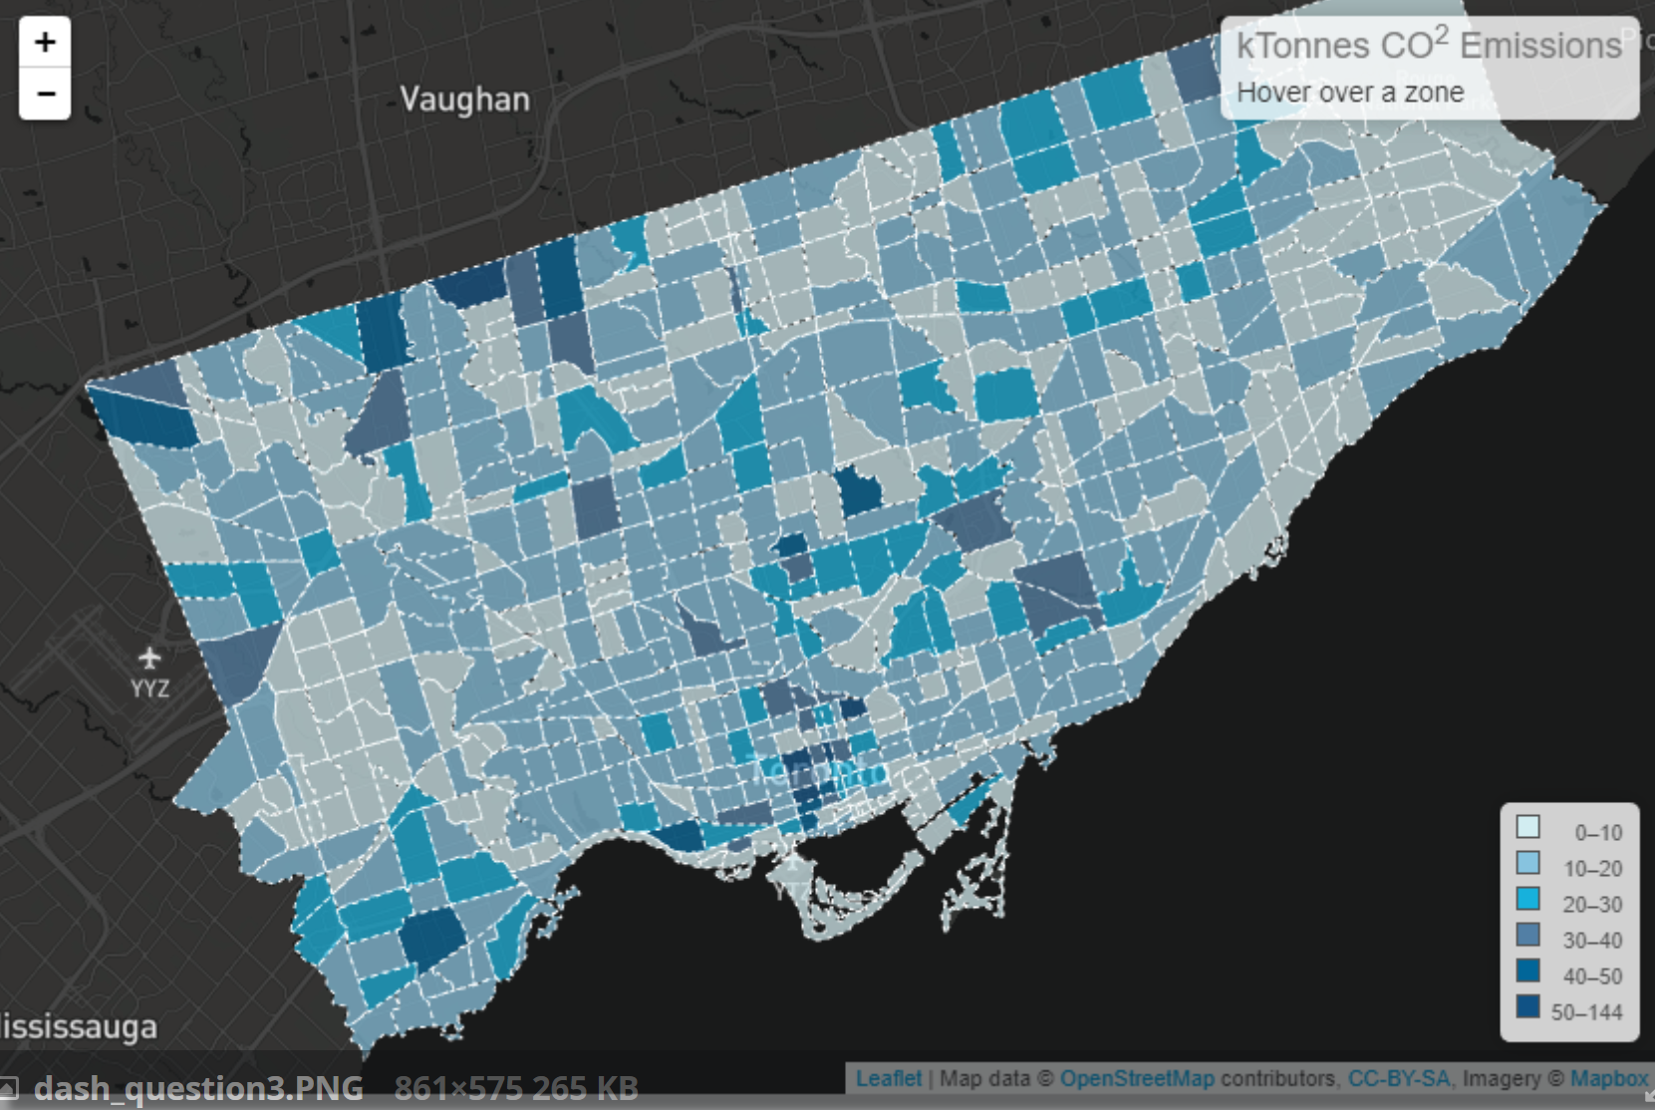
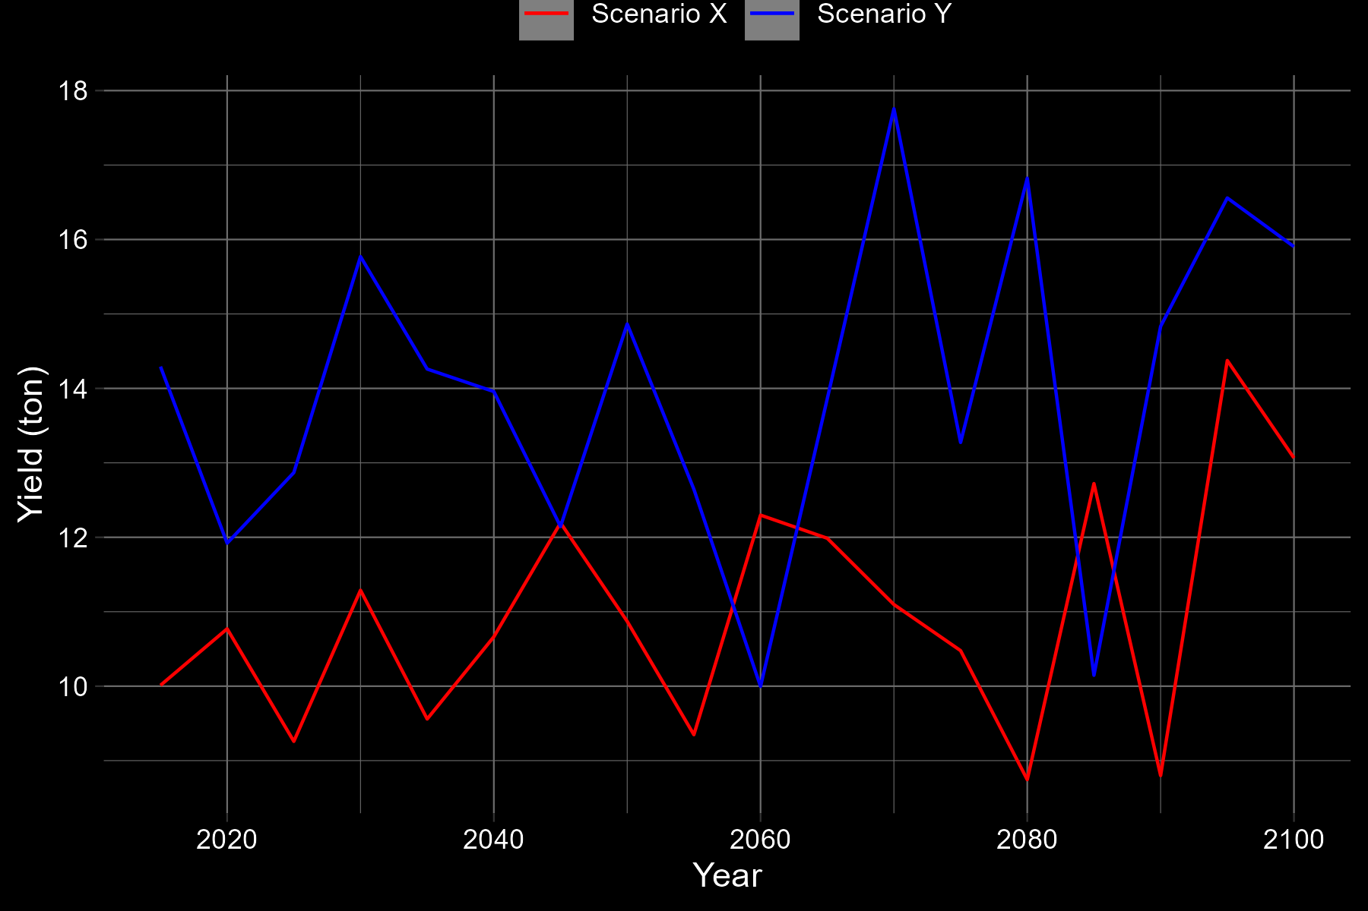
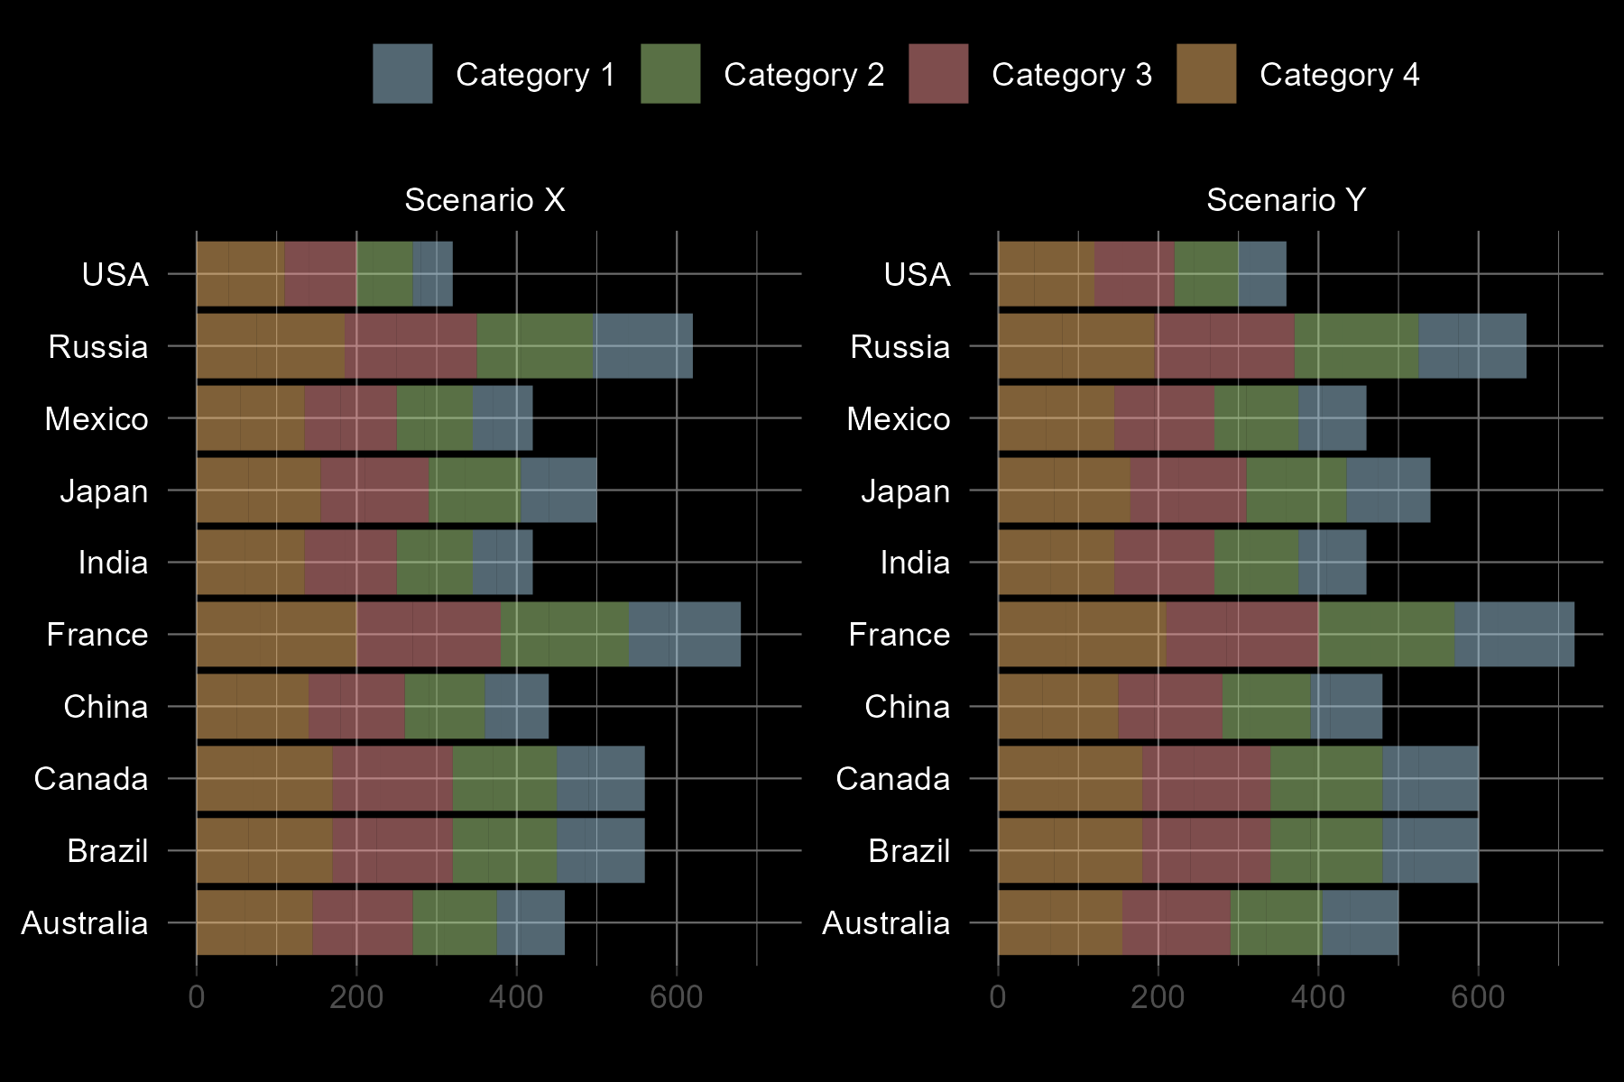


Dataset: Foresight v1
% Change from : 2015 to 2100
Scenario X
Scenario Y
SELECTED: YIELDS .
Global Trends
Spatial Comparison
Top 10 Countries – By Subsector
Scenario X
Scenario Y`

Slide 21
What are your first impressions when you see this dashboard (design, content, takeaways etc.)?
ⓘ Start presenting to display the poll results on this slide.

Slide 22
Dataset: Foresight v1
% Change from : 2015 to 2100
Scenario X
Scenario Y
Selected: Yields (tons) .
Global – All Scenarios
Map – Scenario X vs. Y
Top 10 Countries – By type
Scenario X
Scenario Y`

Slide 23
What are your thoughts on improving this dashboard (design, content, takeaways etc.)?
ⓘ Start presenting to display the poll results on this slide.

Slide 24
Thank You – Come talk to me!
Join at www.slido.com 4138202
POSTER
Wed, 26 Apr
08:30–10:15
Hall X4 | X4.186
GCIMS – Integration:
Reproducible, robust, and scalable workflows for interoperable human-Earth system modeling

